Slide 1
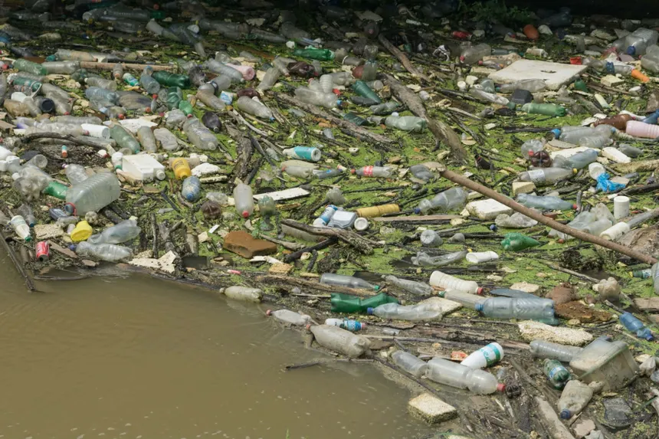
Analysis for: contaminatedwater1.webp
Issue Title: Contaminated Water User Description: A stagnant puddle of contaminated water is spreading a foul smell in the area. Spam Check: Not Spam (Overall Score: 0.45) ------------------------------------ Predicted Department: Water Supply and Sewage Confidence: 99.89% AI Generated Caption: plastic waste in the river Detected Objects: None

Slide 2
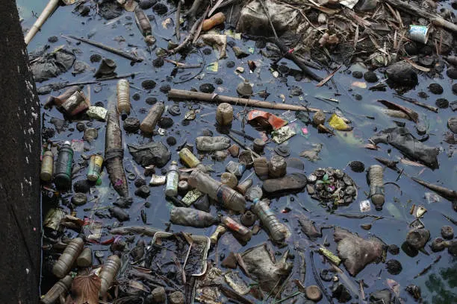
Analysis for: contaminatedwater2.webp
Issue Title: Contaminated Water User Description: The polluted water is posing a serious health risk to nearby residents. Spam Check: Not Spam (Overall Score: 0.46) ------------------------------------ Predicted Department: Water Supply and Sewage Confidence: 99.94% AI Generated Caption: a river filled with garbage Detected Objects: None

Slide 3
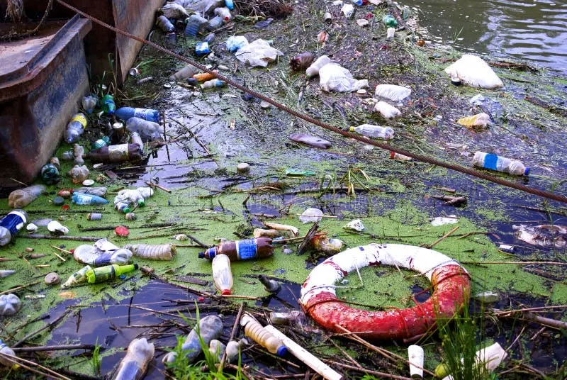
Analysis for: contaminatedwater3.webp
Issue Title: Waterlogging on Road User Description: A big pothole right middle of the road. Spam Check: Potential Spam (Overall Score: 0.26) ------------------------------------ Predicted Department: Water Supply and Sewage Confidence: 100.00% AI Generated Caption: plastic waste in the water Detected Objects: None

Slide 4
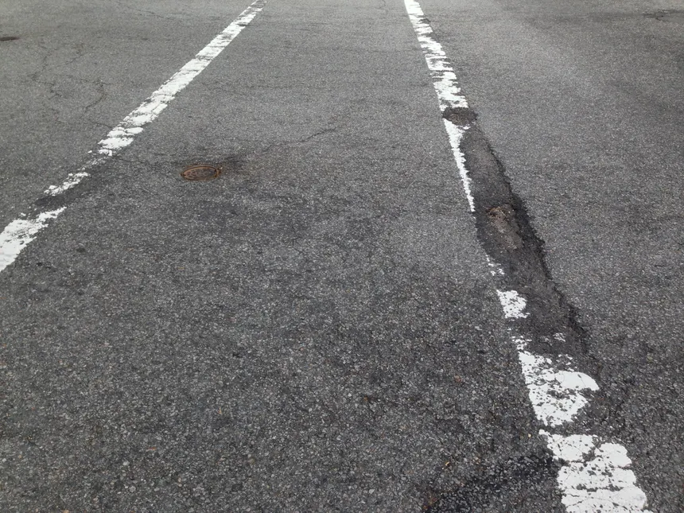
Analysis for: fadedroadmarkings.webp
Issue Title: Faded Road Markings User Description: Road markings are not visible. Spam Check: Not Spam (Overall Score: 0.50) ------------------------------------ Predicted Department: Roads and Potholes Confidence: 99.94% AI Generated Caption: a road with white lines and a white line on the side Detected Objects: baseball glove (0.28)

Slide 5
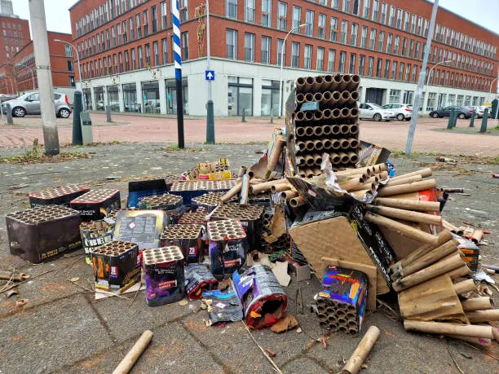
Analysis for: garbage1.webp
Issue Title: Garbage Not Collected User Description: A large pile of trash bags and loose rubbish is overflowing onto the sidewalk next to a building. Spam Check: Not Spam (Overall Score: 0.62) ------------------------------------ Predicted Department: Waste Management Confidence: 94.00% AI Generated Caption: a pile of discarded items on the street Detected Objects: car (0.75), car (0.61), car (0.44), car (0.43)

Slide 6
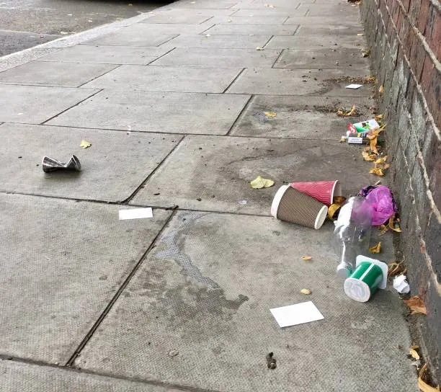
Analysis for: garbage2.webp
Issue Title: Illegal Dumping Of Waste User Description: Contaminated water. Spam Check: Potential Spam (Overall Score: 0.30) ------------------------------------ Predicted Department: Waste Management Confidence: 97.70% AI Generated Caption: a pile of trash on the sidewalk next to a brick wall Detected Objects: bird (0.25)

Slide 7
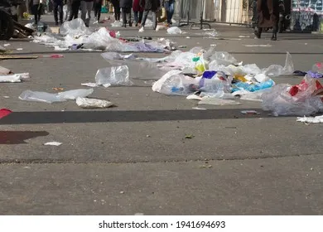
Analysis for: garbage3.webp
Issue Title: Street Sweeping Required User Description: A large collection of garbage bags all over the road. Spam Check: Not Spam (Overall Score: 0.47) ------------------------------------ Predicted Department: Waste Management Confidence: 98.93% AI Generated Caption: a group of people walking down a street with trash Detected Objects: person (0.59), person (0.50), person (0.42), person (0.40), person (0.32), bird (0.29), person (0.28), person (0.28)

Slide 8
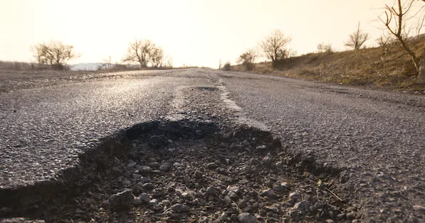
Analysis for: pothole1.webp
Issue Title: Illegal construction Activity User Description: Illegal construction. Spam Check: Potential Spam (Overall Score: 0.18) ------------------------------------ Predicted Department: Roads and Potholes Confidence: 98.84% AI Generated Caption: a pothole on the side of a road Detected Objects: None

Slide 9
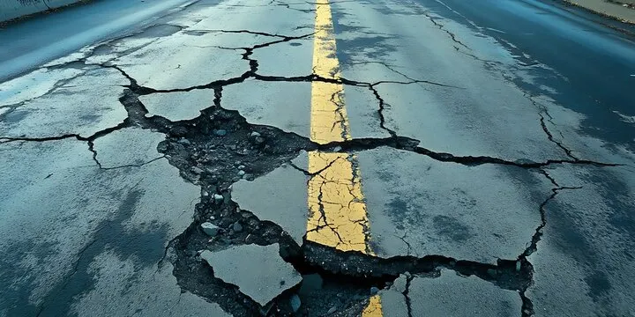
Analysis for: pothole2.webp
Issue Title: Pothole Repair Request User Description: The road surface is severely cracked and broken, creating a driving hazard. Spam Check: Not Spam (Overall Score: 0.60) ------------------------------------ Predicted Department: Roads and Potholes Confidence: 99.96% AI Generated Caption: a road with a cracked road and a yellow line Detected Objects: None

Slide 10
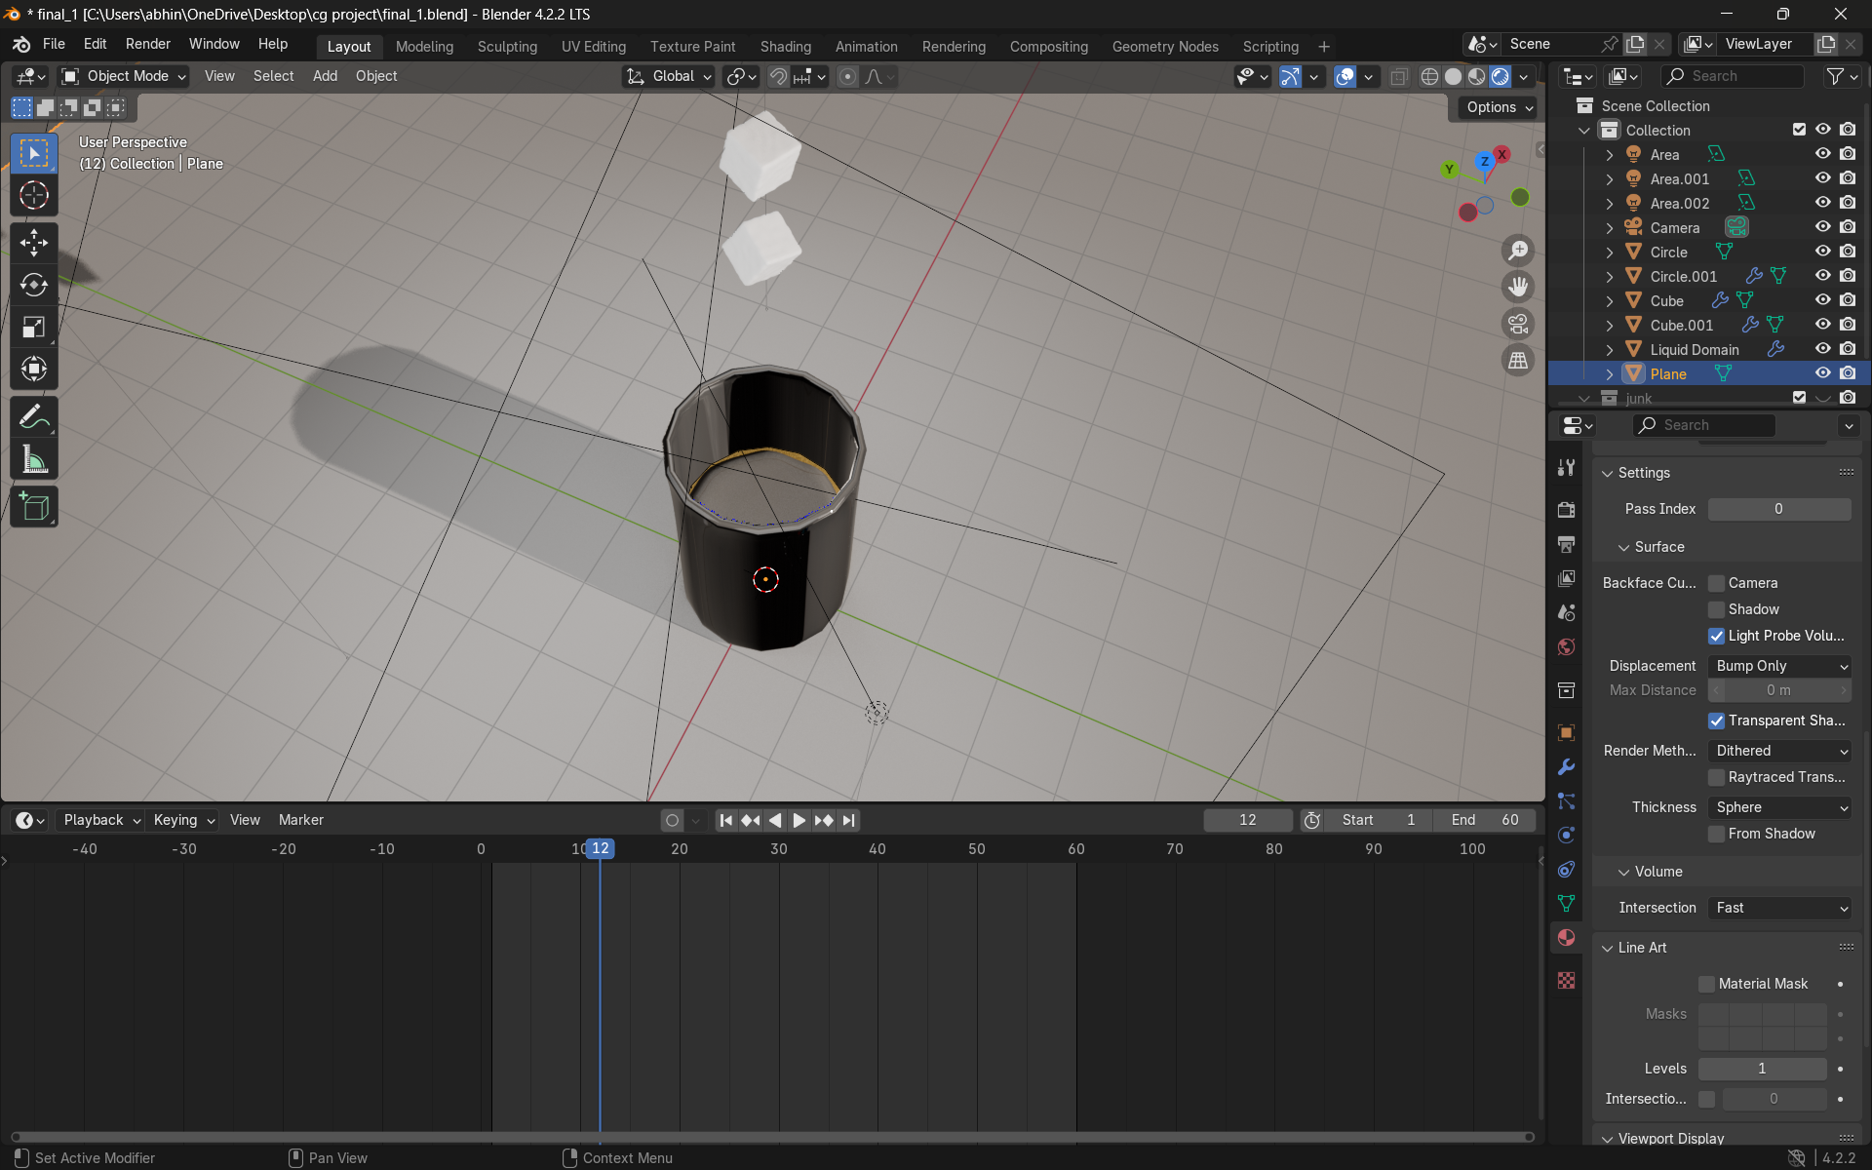
Analysis for: random.png
Issue Title: Broken Speed Breaker User Description: Damaged speed Breaker. Spam Check: Potential Spam (Overall Score: 0.04) ------------------------------------ Predicted Department: Water Supply and Sewage Confidence: 82.53% AI Generated Caption: the blend blender in blender Detected Objects: toilet (0.58)

Slide 11
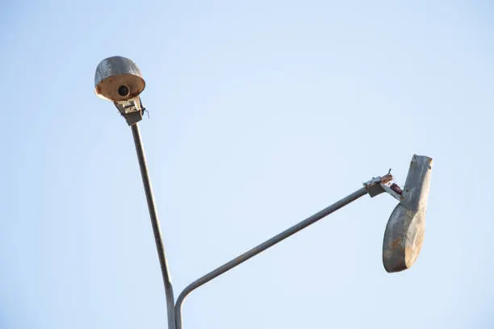
Analysis for: stbroken1.webp
Issue Title: Damaged Street Light User Description: Broken streetlight. Spam Check: Not Spam (Overall Score: 0.62) ------------------------------------ Predicted Department: Streetlight and Electricity Confidence: 99.84% AI Generated Caption: a street light with a bird on it ' s head Detected Objects: airplane (0.52)

Slide 12
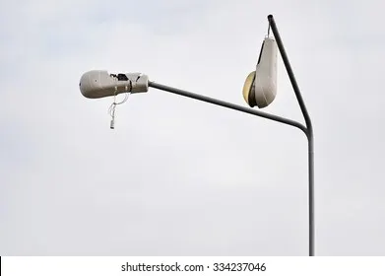
Analysis for: stbroken2.webp
Issue Title: Damaged Street Light User Description: Streetlight is broken. Spam Check: Not Spam (Overall Score: 0.59) ------------------------------------ Predicted Department: Streetlight and Electricity Confidence: 99.84% AI Generated Caption: a street light with a cloudy sky in the background Detected Objects: None

Slide 13
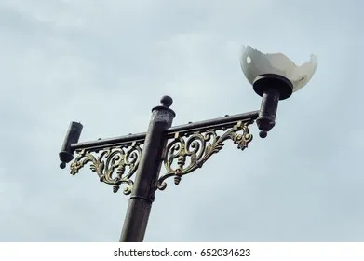
Analysis for: stbroken3.webp
Issue Title: Frequent Power Cuts User Description: overflowing manhole. Spam Check: Potential Spam (Overall Score: 0.01) ------------------------------------ Predicted Department: Streetlight and Electricity Confidence: 99.99% AI Generated Caption: a bird is perched on a street light Detected Objects: None

Slide 14
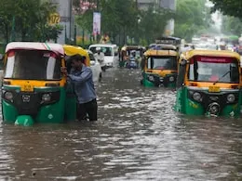
Analysis for: wl1.webp
Issue Title: Waterlogging on Road User Description: A city street is completely flooded. Spam Check: Not Spam (Overall Score: 0.69) ------------------------------------ Predicted Department: Roads and Potholes Confidence: 98.89% AI Generated Caption: a flooded street in mumbai Detected Objects: person (0.80), boat (0.61), truck (0.55), suitcase (0.44), boat (0.44), suitcase (0.43), suitcase (0.39), suitcase (0.37), car (0.30), car (0.28), truck (0.26)

